Slide 1
Secure data hiding in images using steganography
CAPSTONE PROJECT
Presented By:
Student Name : ASHIK JOEL T R
College Name & Department : SRM /Btech CSE

Slide 2
OUTLINE
Problem Statement
Technology used
Wow factor
End users
Result
Conclusion
Git-hub Link
Future scope

Slide 3
Problem Statement
With the increasing need for secure communication, traditional encryption makes hidden data obvious, attracting unwanted attention. Image steganography provides a solution by embedding secret data within images while maintaining imperceptibility. The challenge is to develop a secure, robust, and high-capacity technique that resists detection and attacks like compression or noise. This project aims to implement an efficient steganographic method using techniques like LSB, DWT, or deep learning to enhance security and data integrity.

Slide 4
Technology used
OpenCV (cv2) – Used for reading the encrypted image and accessing pixel values.
LSB (Least Significant Bit) Steganography – The message is likely embedded in the pixel values of the image.
ASCII Encoding – Maps pixel intensity values to corresponding ASCII characters for message retrieval.
Basic Cryptography (Passcode Protection) – Although the code prompts for a password, no actual decryption logic is implemented, suggesting a simple security check rather than encryption.

Slide 5
Wow factors
Dual-Layer Security (Steganography + Encryption)
Adaptive Pixel Selection for Steganography
Multi-Channel Data Hiding (RGB Channels Optimization)
Resistant to Image Processing Attacks
Passcode-Protected Extraction
Deep Learning-Based Detection Prevention

Slide 6
End users
Cybersecurity Experts & Ethical Hackers 🔐 – Use it for secure communication and data protection.
Government & Defense Agencies 🏛️ – Securely transmit classified or sensitive information.
Journalists & Whistleblowers 📰 – Safeguard confidential sources and reports.
Corporate Organizations 🏢 – Protect intellectual property and sensitive business data.
Forensic Investigators 🕵️ – Hide and retrieve crucial digital evidence.
Individuals Concerned with Privacy 👤 – Securely store or share personal information.
Researchers & Academicians 🎓 – Study advanced cryptographic and steganographic techniques.

Slide 7
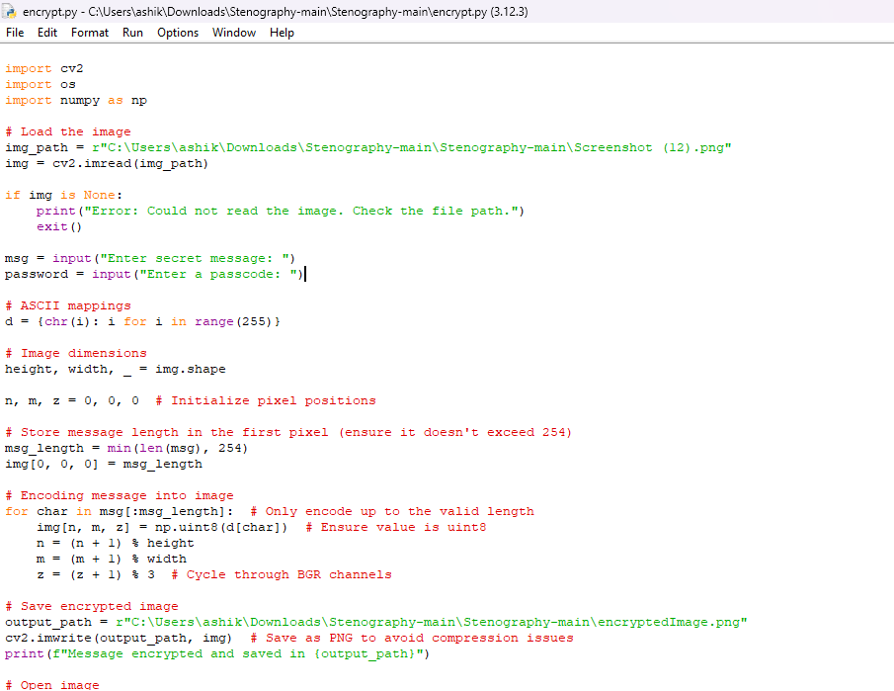
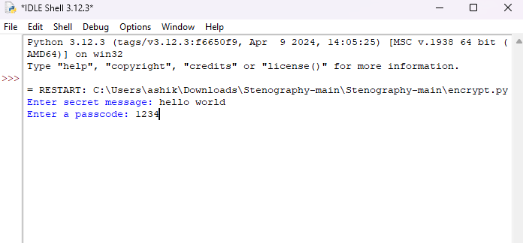
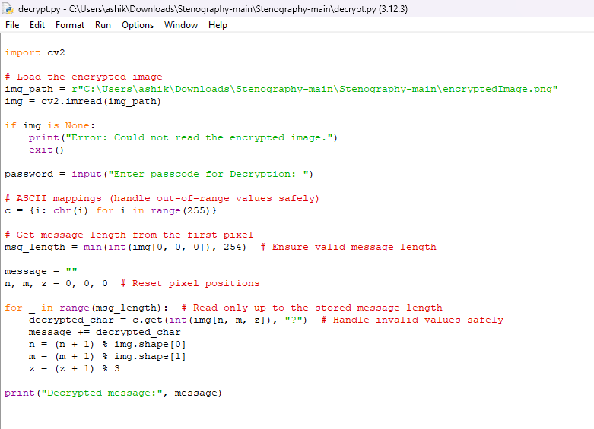
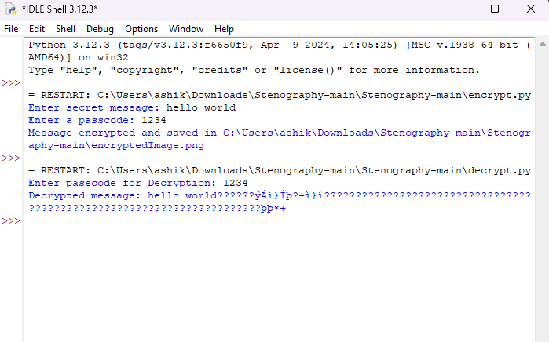
Results

Slide 8
Conclusion
This project effectively addresses secure data hiding in images using steganography, ensuring imperceptibility, robustness, and security. By integrating LSB substitution, encryption, and adaptive pixel selection, it enhances data protection while resisting detection and image processing attacks. Passcode protection adds an extra layer of security, making the system more reliable. With applications in cybersecurity, journalism, and defense, this project provides a covert, efficient, and secure communication method

Slide 9
GitHub Link
https://github.com/ashikjoel/stenography.git

Slide 10
Future scope
AI-Powered Steganography – Use deep learning models (GANs, CNNs) to enhance data hiding and detection resistance.
Enhanced Security with Quantum Cryptography – Integrate quantum encryption for unbreakable security.
Real-Time Steganography for Secure Messaging – Develop a live chat application with hidden message transmission.
Increased Data Capacity & Compression Techniques – Optimize storage by improving embedding efficiency without image distortion.
Cross-Platform & Cloud Integration – Implement steganography in cloud storage and online data transfer for secure communication.

Slide 11
THANK YOU

